Slide 1
Welcome to all
for the MHRM Online lecture
By
Dr. Dhiraj Ovhal
HOD of Commerce

Slide 2
Chapter -2
Marketing Decision –I
(Product and Price)

Slide 3
Q.4 Brand Equity concept and Factors ?
Meaning:-
To create addition values and images in the mind of customers ( Nirma Washing powder and Nirma Biscuits
Dettol soft drink...)
Definition :-
Edward Tauber defines "The incremental value of business above the value of its physical assets due to market position achieved by its brand and the extension potential of the brand ."

Slide 4
Factors of branding
Brand loyalty
Brand Name awareness
Brand Association
After sales service
Brand Ambassadors
Brand patent
Brand Logo

Slide 5
Brand Equity:-
It means fix image in the mind of customers
To create addition values and images in the mind of customers
( Nirma Washing powder and Nirma Biscuits
Dettol soft drink...)
( Brand equity ---- Incremental Values fill in the blanks for One mark question)

Slide 6
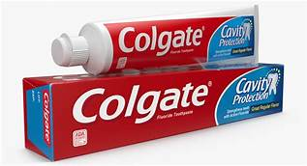
Brand loyalty:-
Satisfied customers of products
Customers are not only purchasing products but also recommend or suggested to their family members of society.
It is called as Evangelist

Slide 7
2. Brand Name awareness :-
In the mind of customers
Corporate name:- Tata Salt, Tata Nano, Tata Hexa,
Corporate cum Individual brand name :- Cadbury dairy milk
Umbrella name:- Amul Butter, Amul milk, Amul chocolate
Founder name:- Colgate,Nestle, Ford

Slide 8
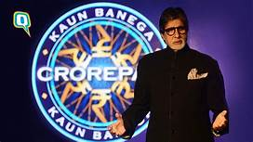
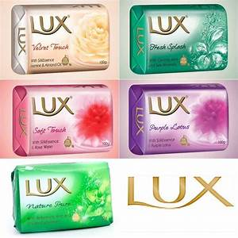
3. Brand Association:-
A brand must link or connect to certain association
Lux soap- Association of bollywood actress
Goa- Association of beautiful beaches
kerala- Backwater experience and Ayurvedic massage

Slide 9
4. After sales service :-
It is providing to make difference in brand equity
It is applicable consumer durable products
Warranty and Guarantee
To provide staff training for after sales service.

Slide 10
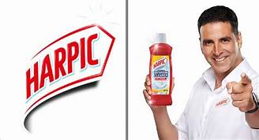
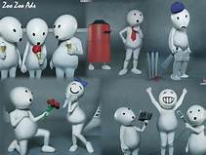
5. Brand Ambassadors :-Famous personality to promote products as brand ambassadors.

Slide 11
6. Brand patent :-
Company attain patent for new and innovative products
Need to register under Patent Act
In India products may be registered under Patents (Amendment) Act 2005

Slide 12
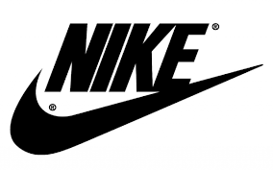
7. Brand Logo :- along with brand name it facilitate to customers
Nike √,

Slide 13
Factors of branding
Brand loyalty
Brand Name awareness
Brand Association
After sales service
Brand Ambassadors
Brand patent
Brand Logo

Slide 14
Thank You

